Slide 1
Title:Variable Selection Techniques for High-Dimensional Simulated Data & Real Data (Bike Rentals)
Prince Kofi & Shinjon Ghosh
Graduate Student
Department of Mathematics

Slide 2
Introduction
In the era of big data, selecting the most relevant variables from a high-dimensional dataset is essential for building interpretable and efficient predictive models.
This project explores variable selection techniques by combining insights from both simulated data and a real-world dataset involving bike rental counts.

Slide 3
Goals
Simulated Study :
Evaluate and compare the variable selection ability of different models (Poisson GLM, Lasso, Elastic Net, Random Forest, XGBoost, Bayesian Regression[Normal & Laplace Prior])
Use False Positive Rate (FPR), False Negative Rate (FNR), and True Positive Rate (TPR) to evaluate model performance.
Visualize variable importance and selection consistency across methods.
Real Data Study :
Analyze variable importance using all models above.
Interpret the impact of variables on bike rentals and compare how each model highlights different predictors.
Provide practical policy insights on which factors drive bike rentals.

Slide 4
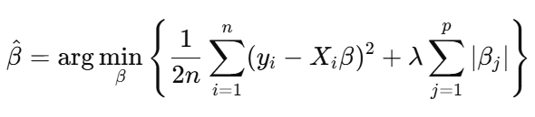
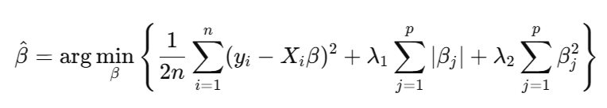
Variable Selection Methods
Poisson GLM
log (𝐸(𝑦𝑖)) = log(𝜇𝑖) = 𝛽0 + 𝛽1𝑋𝑖1 + ⋯ + 𝛽𝑝𝑋𝑖𝑝
LASSO
Elastic Net

Slide 5
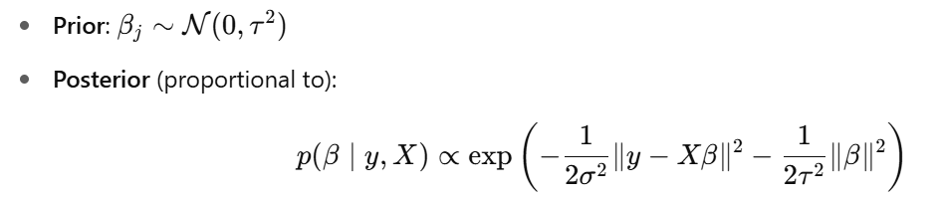
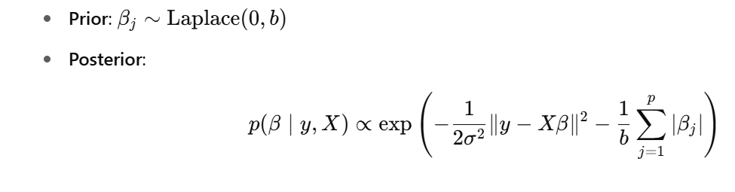
Variable Selection Methods
Bayesian Regression
Normal –
Laplace -

Slide 6
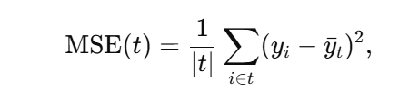
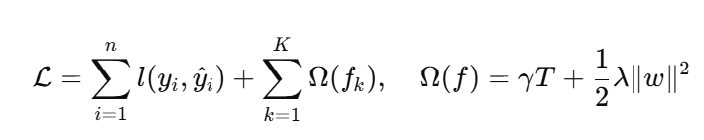


Variable Selection Methods
Random Forest –
XGBoost –
Spike & Slab
Prior –
Posterior -

Slide 7
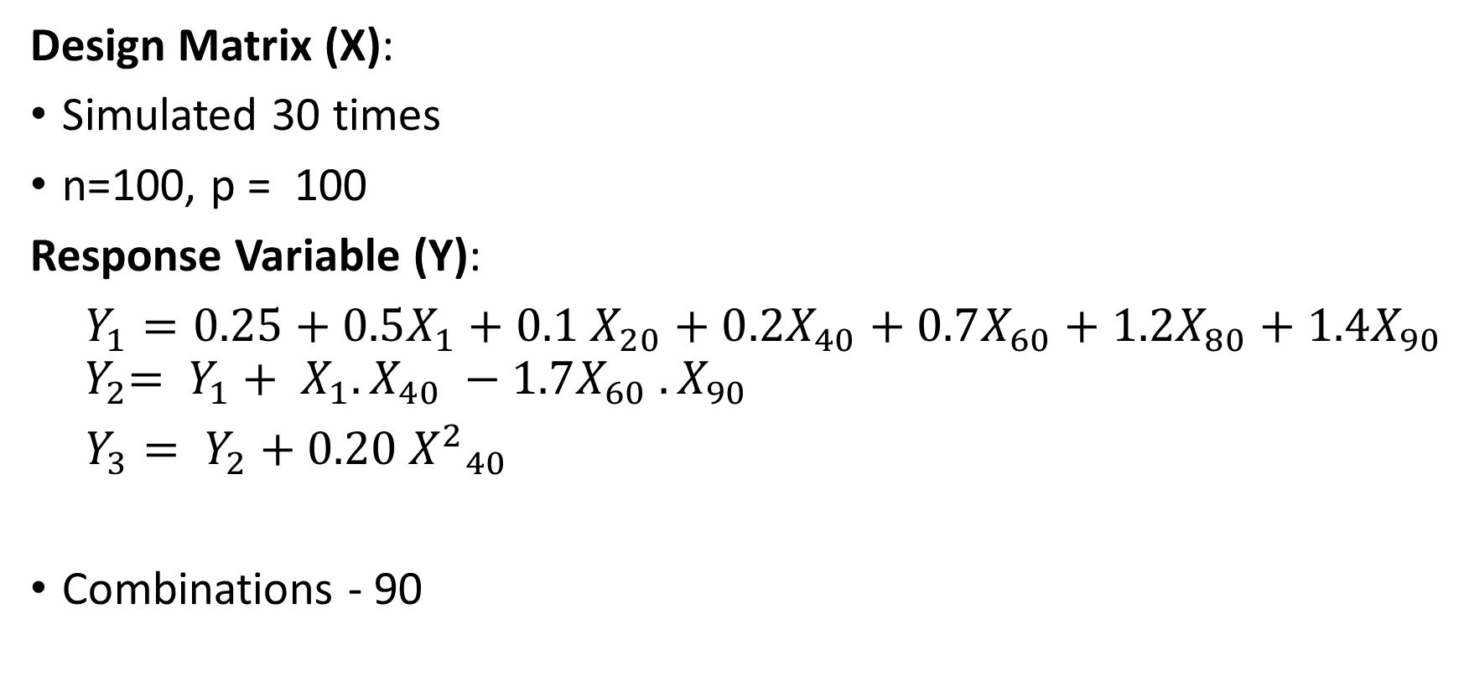
Simulated Data Analysis - Dataset Design
Design Matrix (X):
Simulated 30 times
n=100, p = 100
Response Variable (Y):
$Y_{1}=0.25+0.5X_{1}+0.1 X_{20}+0.2X_{40}+0.7X_{60}+1.2X_{80}+1.4X_{90}$
$${ Y}_{2}= Y_{1}+ X_{1}. X_{40} −1.7X_{60} . X_{90}$$
$Y_{3}= Y_{2}+0.20{{ X}^{2}}_{40}$
Combinations - 90

Slide 8




Evaluation Metrics
True Positive (TP): A variable that is truly relevant (important) and was correctly selected by the model.
TPR = $\frac{TP}{TP+FN}$
False Positive (FP): A variable that is not truly relevant, but the model incorrectly selected it.
FPR = $\frac{FP}{FP+TN}$
True Negative (TN): A variable that is not relevant and was correctly not selected.
TNR = $\frac{TN}{TN+FP}$
False Negative (FN): A variable that is relevant, but the model failed to select it.
FNR = $\frac{FN}{FN+TP}$

Slide 9
Results – Poisson GLM vs Lasso Vs Elastic Net
Response | Model | TP | FP | FN | TN | FPR | FNR
y1 | ElasticNet | 5.87 | 41.9 | 0.13 | 52.1 | 0.446 | 0.0222
y1 | GLM | 6.00 | 94.0 | 0.00 | 0.00 | 1.000 | 0.0000
y1 | LASSO | 5.90 | 23.3 | 0.10 | 70.7 | 0.248 | 0.0167
y2 | ElasticNet | 3.53 | 31.2 | 2.47 | 62.8 | 0.332 | 0.4110
y2 | GLM | 6.00 | 94.0 | 0.00 | 0.00 | 1.000 | 0.0000
y2 | LASSO | 3.70 | 27.7 | 2.30 | 66.3 | 0.294 | 0.3830
y3 | ElasticNet | 3.43 | 25.7 | 2.57 | 68.3 | 0.273 | 0.4280
y3 | GLM | 6.00 | 94.0 | 0.00 | 0.00 | 1.000 | 0.0000
y3 | LASSO | 3.67 | 24.5 | 2.33 | 69.5 | 0.261 | 0.3890

Slide 10
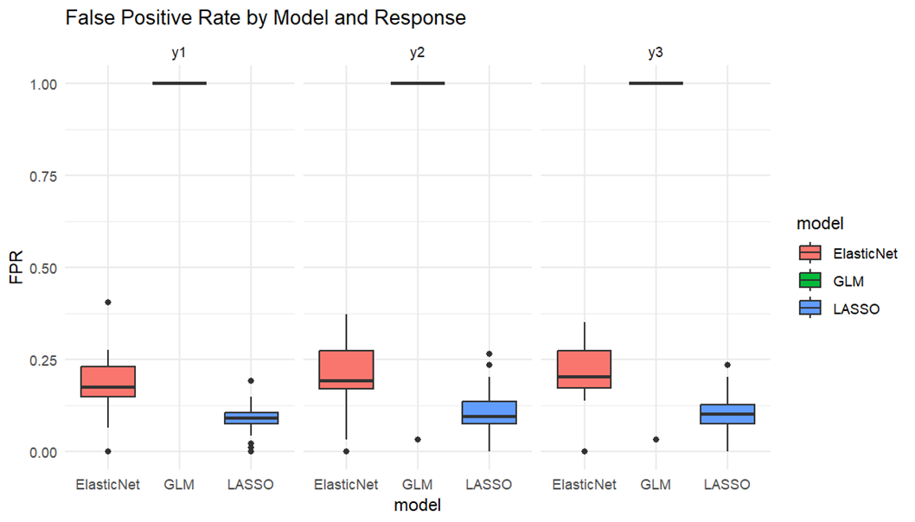
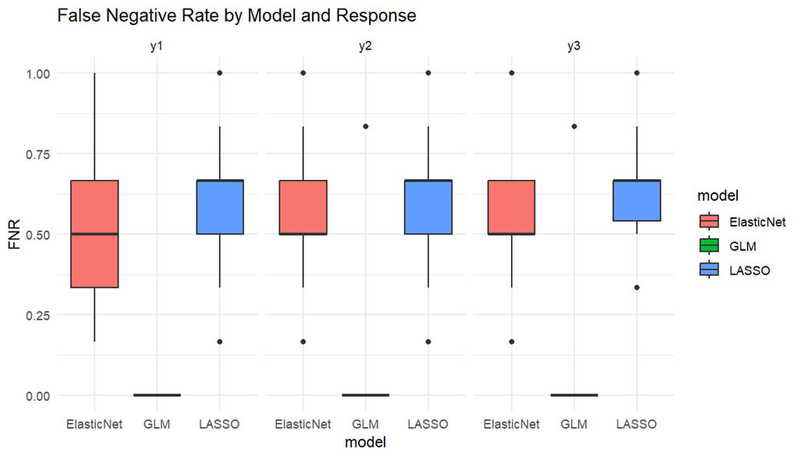
Results – Poisson GLM vs Lasso Vs Elastic Net

Slide 11
Results – RandomForest vs XGBoost
Response | Model | TP | FP | FN | TN | TPR | TNR
y1 | RandomForest | 2.93 | 7.07 | 3.07 | 86.9 | 0.489 | 0.925
y1 | XGBoost | 3.10 | 6.90 | 2.90 | 87.1 | 0.517 | 0.927
y2 | RandomForest | 1.80 | 8.20 | 4.20 | 85.8 | 0.300 | 0.913
y2 | XGBoost | 2.97 | 7.03 | 3.03 | 87.0 | 0.494 | 0.925
y3 | RandomForest | 1.77 | 8.23 | 4.23 | 85.8 | 0.294 | 0.912
y3 | XGBoost | 3.13 | 6.87 | 2.87 | 87.1 | 0.522 | 0.927

Slide 12
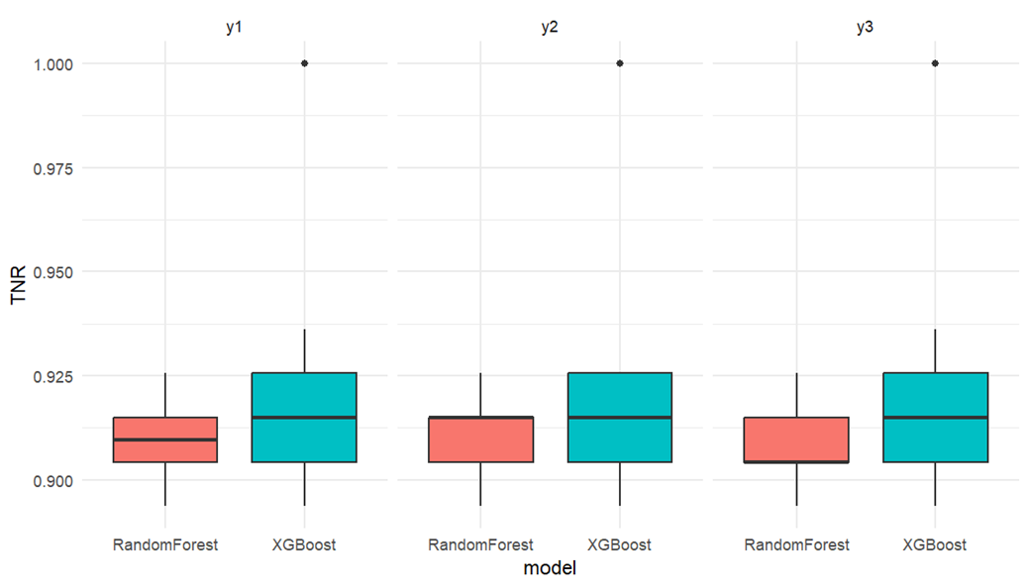
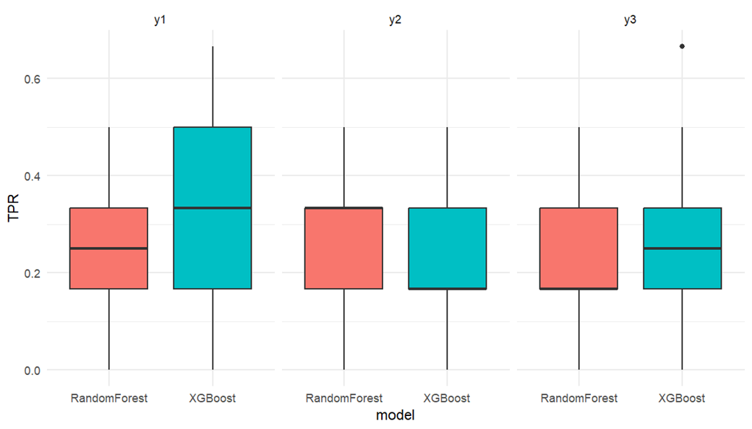
Results – RandomForest vs XGBoost

Slide 13
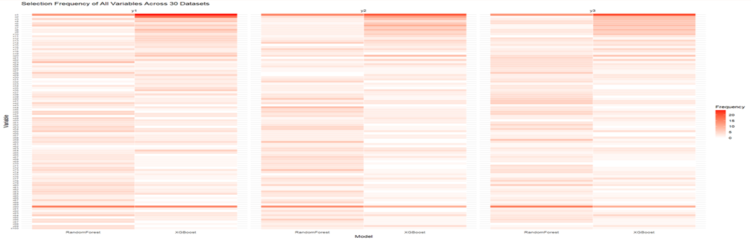
Results – RandomForest vs XGBoost

Slide 14
Results – Normal prior vs. Laplace prior in Bayesian regression
Response | Model | Mean TP | Mean FP | Mean FN | Mean TN | Mean TPR | Mean TNR
y1 | NormalPrior | 0.300 | 3.10 | 4.70 | 91.90 | 0.060 | 0.967
y1 | LaplacePrior | 0.367 | 2.97 | 4.63 | 92.00 | 0.073 | 0.969
y2 | NormalPrior | 0.700 | 10.00 | 4.30 | 85.00 | 0.140 | 0.895
y2 | LaplacePrior | 0.600 | 8.70 | 4.40 | 86.30 | 0.120 | 0.908
y3 | NormalPrior | 0.833 | 12.40 | 4.17 | 82.60 | 0.167 | 0.870
y3 | LaplacePrior | 0.767 | 11.30 | 4.23 | 83.70 | 0.153 | 0.881

Slide 15
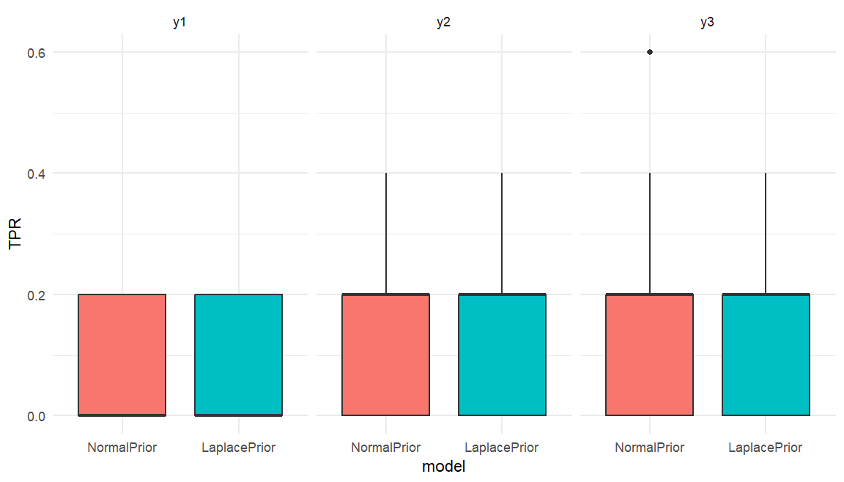
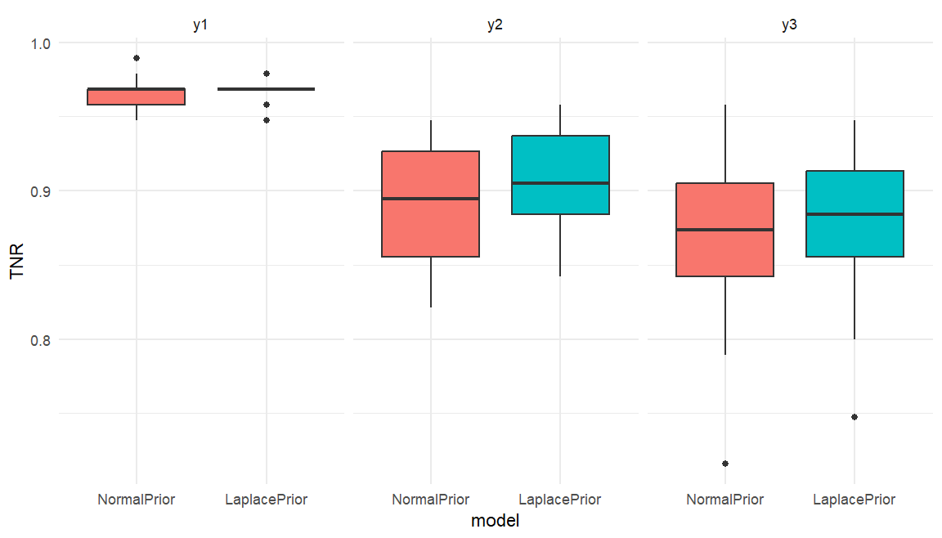
Results – Normal prior vs. Laplace prior in Bayesian regression

Slide 16
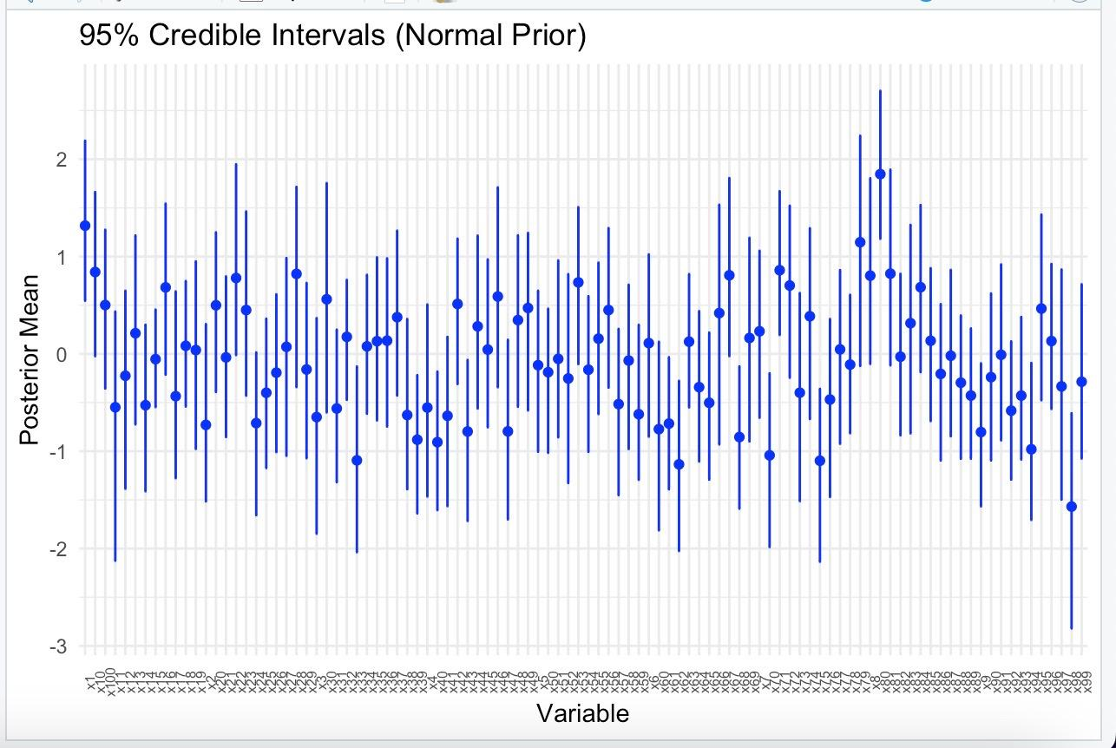
Results – Normal prior vs. Laplace prior in Bayesian regression

Slide 17
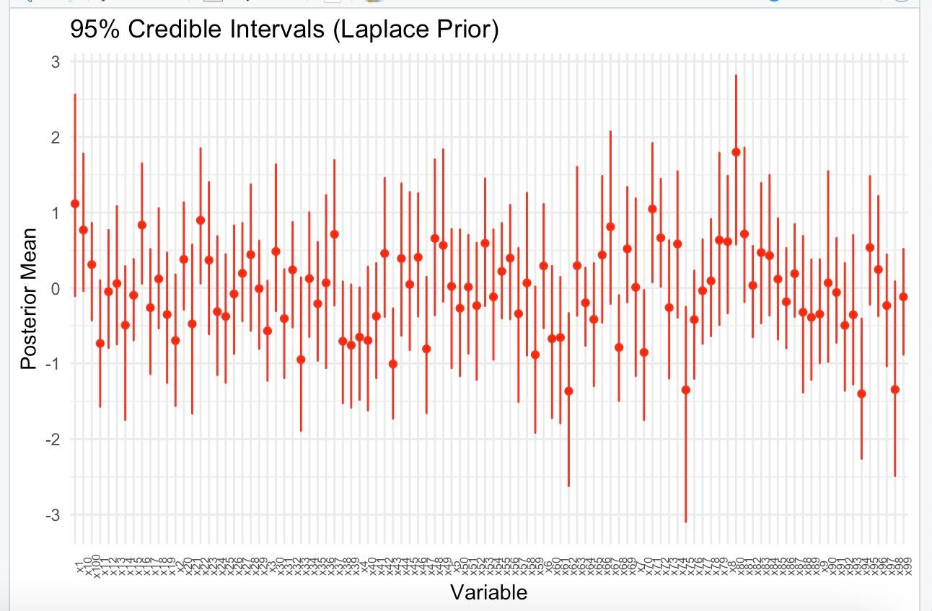
Results – Normal prior vs. Laplace prior in Bayesian regression

Slide 18
Real Data Analysis – Data Collection & Description
Data Sources:
• Secondary: Capital Bikeshare (Washington D.C., 2011–2012)
• Weather: Integrated from FreeMeteo (temp, humidity, windspeed)
Dataset Overview:
• 731 daily records, 16 variables (hourly/daily aggregation)
Key Variables:
• Response: cnt (total rentals)
• Predictors:
• Temporal: Season, holiday, working day
• Weather: Temp (°C), humidity (%), windspeed (m/s)

Slide 19
Real Data Analysis – Poisson GLM vs Lasso vs Elastic Net

Slide 20
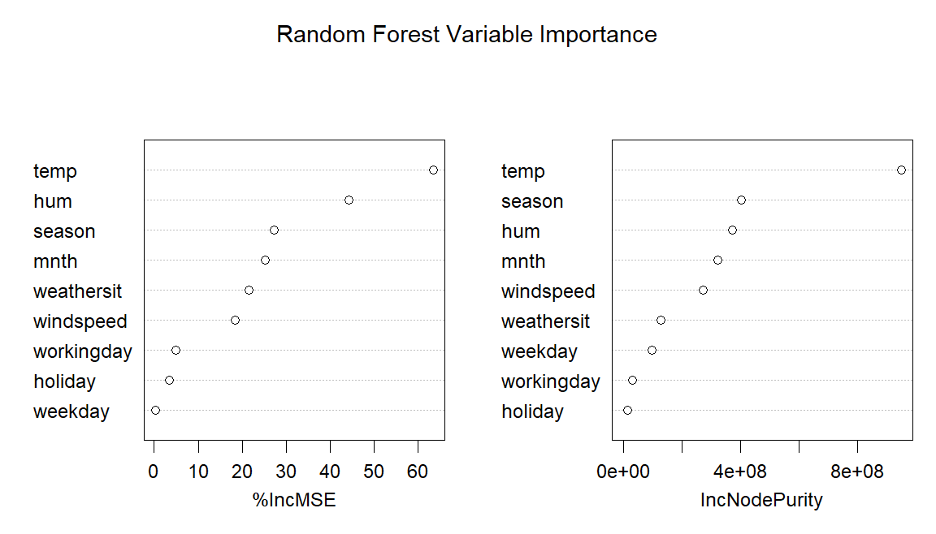
Real Data Analysis – Random Forest

Slide 21
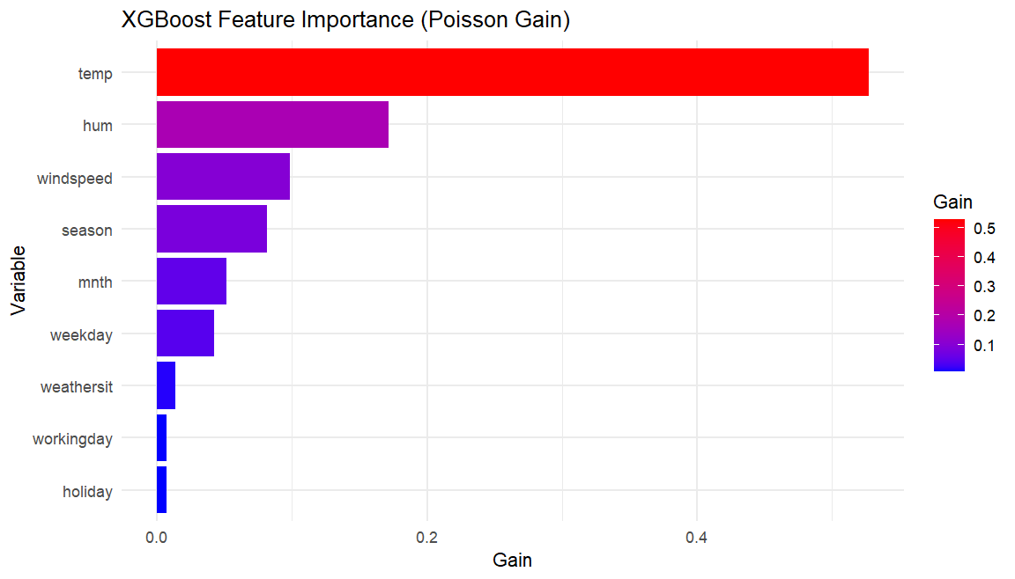
Real Data Analysis – XGBoost

Slide 22
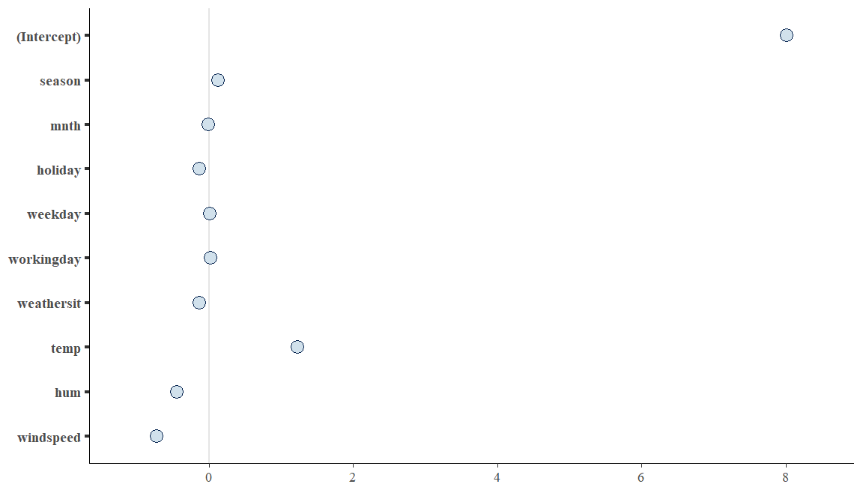

Real Data Analysis – Bayesian Regression – Normal vs Laplace

Slide 23
Conclusion
Simulated Data Analysis
Based on FPR, FNR & Boxplot analysis, Lasso outperforms Poisson GLM and Elastic Net in variable selection performance.
Based on TPR, TNR & Boxplot analysis, XGBoost demonstrates better variable selection ability compared to Random Forest.
According to the mean TPR, mean TNR, & Line plot results, Bayesian regression with a Laplace prior shrinks more unimportant variables to zero than the Normal prior, indicating stronger sparsity(the variables go to zero).
Real Data Analysis
From Poisson GLM Model analysis, we can say that season, mnth, holiday, weekday, workingday, weathersit, temp, hum, windspeed variables significantly affect cnt (number of bike rentals).
According to Lasso and Elastic Net coefficient analysis, season, temp(positively), & hum, windspeed, holiday, weathersit (negatively) in predicting bike rentals.
Based on Random Forest Analysis, temp, mnth, windspeed, hum, and season are more important variables. Moreover, in XGBoost Analysis, temp, hum, windspeed, and season are more influential variables in predicting bike rentals.
According to the Dot-Whisker plot, Bayesian regression with normal and Laplace prior shrinks more unimportant variables to zero. Only the temp variable has a significantly positive effect, and hum, windspeed variables have a significantly negative effect on predicting bike rentals.

Slide 24
Limitations & Future Developments
Simulation study:
Use limited iterations and hyperparameters.
Implement hierarchical priors and empirical Bayes to optimize model flexibility.
Real Data Study:
Different locations, sample sizes, and data collection periods may
lead to diverse findings.
Broader considerations can improve understanding of bike rental demand and enhance model accuracy.

Slide 25

Any Questions or Suggestions???

